Slide 1


SMART INDIA HACKATHON 2025
TITLE PAGE
PROBLEM STATEMENT ID –SIH25168
PROBLEM STATEMENT TITLE-ENHANCING FARMER PRODUCTIVITY THROUGH INNOVATIVE TECHNOLOGY SOLUTIONS
THEME- AGRICULTURE, FOODTECH & RURAL DEVELOPMENT
PS CATEGORY- SOFTWARE
TEAM ID- 78800
TEAM NAME (REGISTERED ON PORTAL)- CIPHER-SQUAD
Notes:
after introducing the team, introduce the problem statement first, then spit out some facts and figures about jharkhand

Slide 2

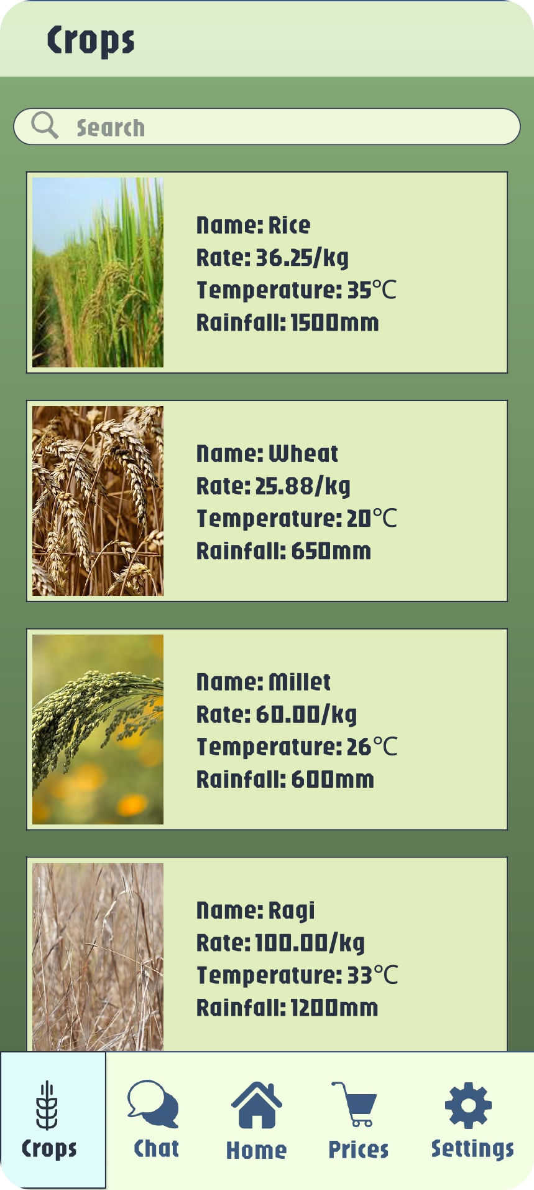
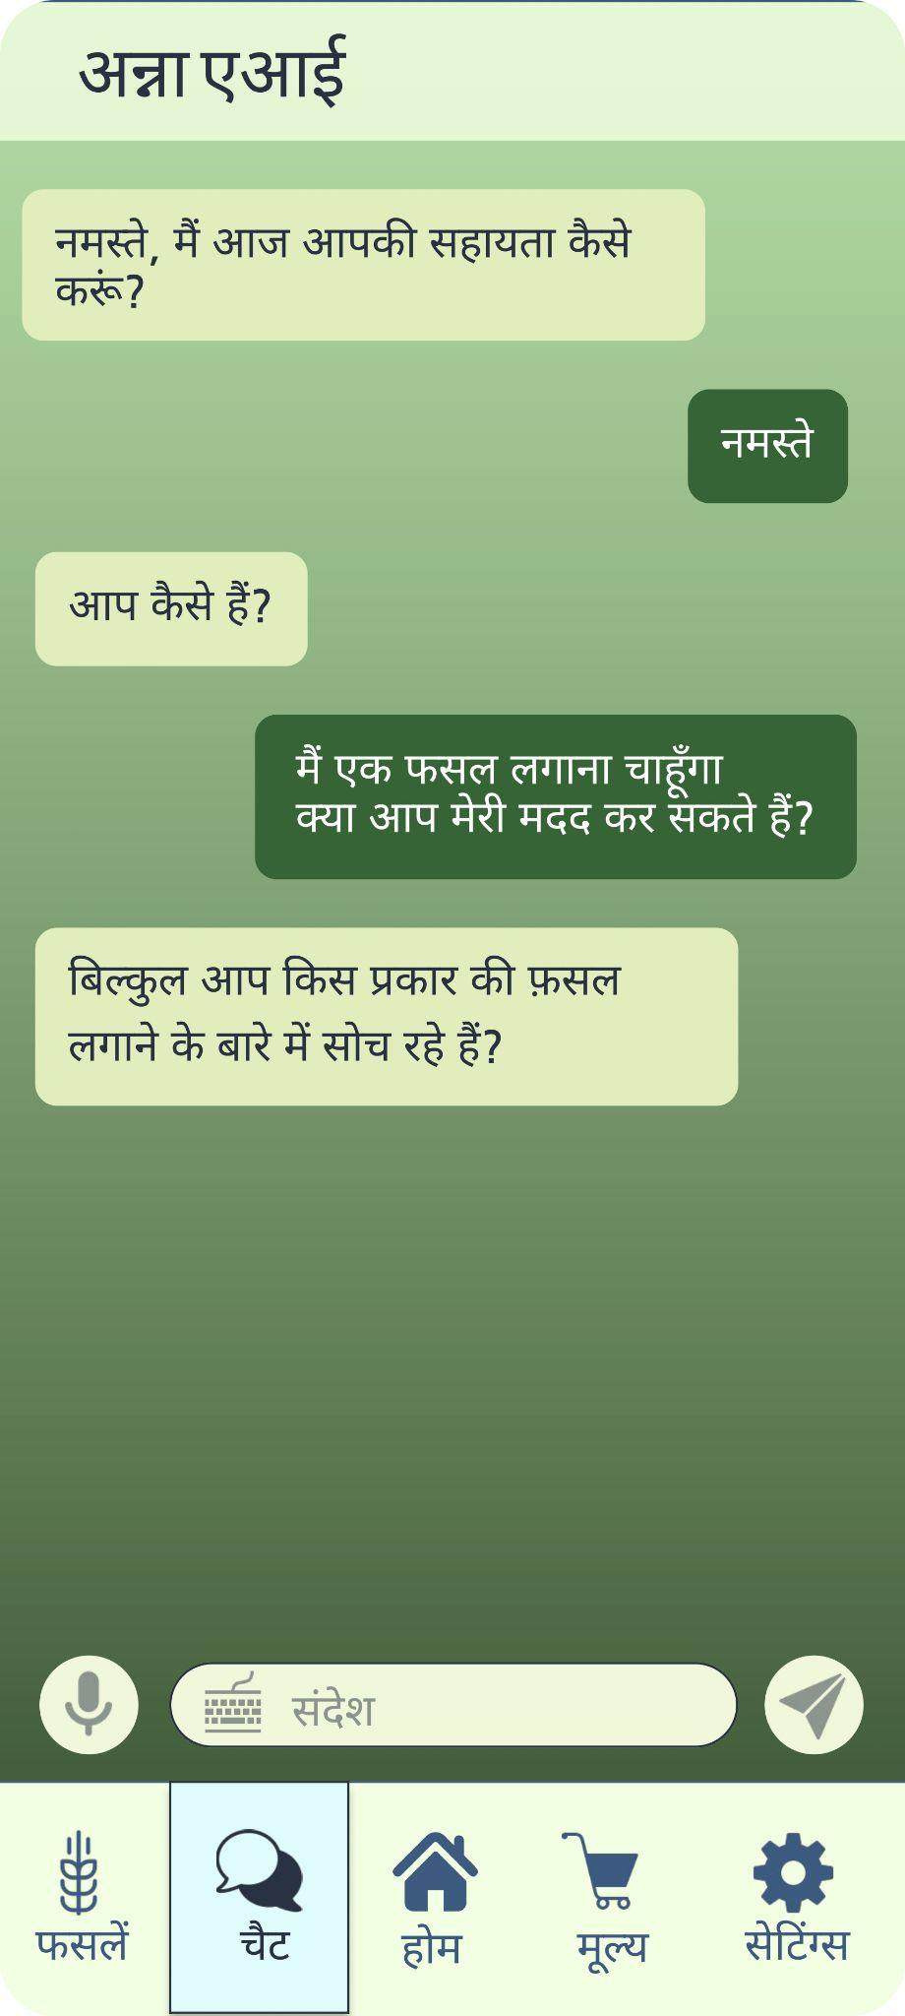
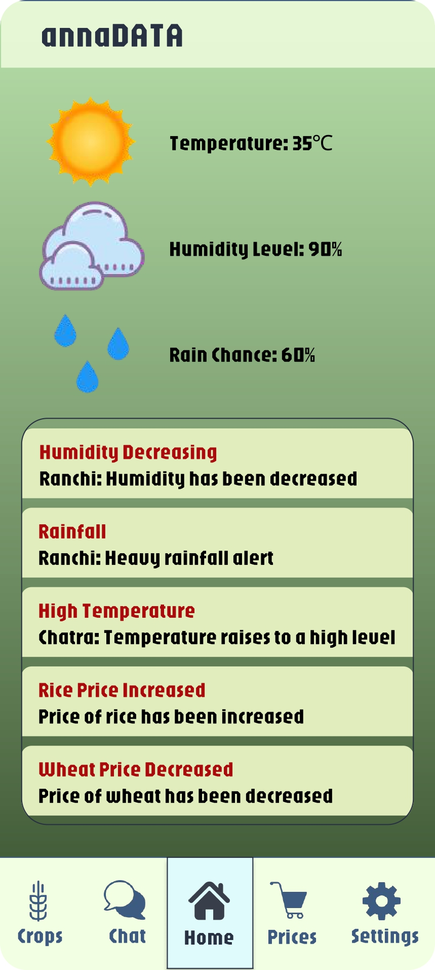
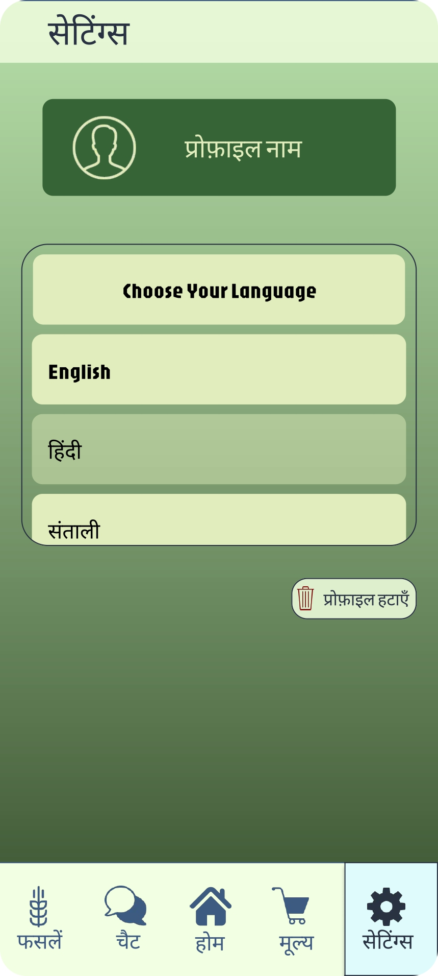
Cipher
Squad
annaDATA
Our Promise to Farmers
Smart planning for every harvest
Accurate crop health insights
Profit insights at every stage
Timely alerts and recommendations
Sustainable land use and soil protection
Optimized resource usage for efficiency
How It Works
Crop Recommendation: Suggests crops using soil, weather, and resource data.
Yield & Profit Calculation: Computes expected output and revenue using inputs, crop type, and local market trends.
Disease Detection: Analyzes crop images to identify issues early.
Market Adjustment: Considers regional trends to guide planting decisions.
Notes:
First say about the app’s features then explain the points
Smart plan – soil health, weather forecast, market prices. Tells the best crops to grow in the upcoming seasons
Plant doctor – take a picture of plant and upload; tells you whats wrong and gives remedies
Profit – calculates the money that can be earned from the size of your land and the crop.
Farming assistant – sends reminders for watering,adding fertilizers,bad weather, to take action
Personal & simple- personalized advice on soil, location, history using pics (include voice chat)
Stp b stp guide- during disease treatment, gives simple lists of steps-> easy to follow
Clear financial- shows expected income & expenses, avoiding unexpected costs
Works evrywhr- network availability and how the app performs

Slide 3
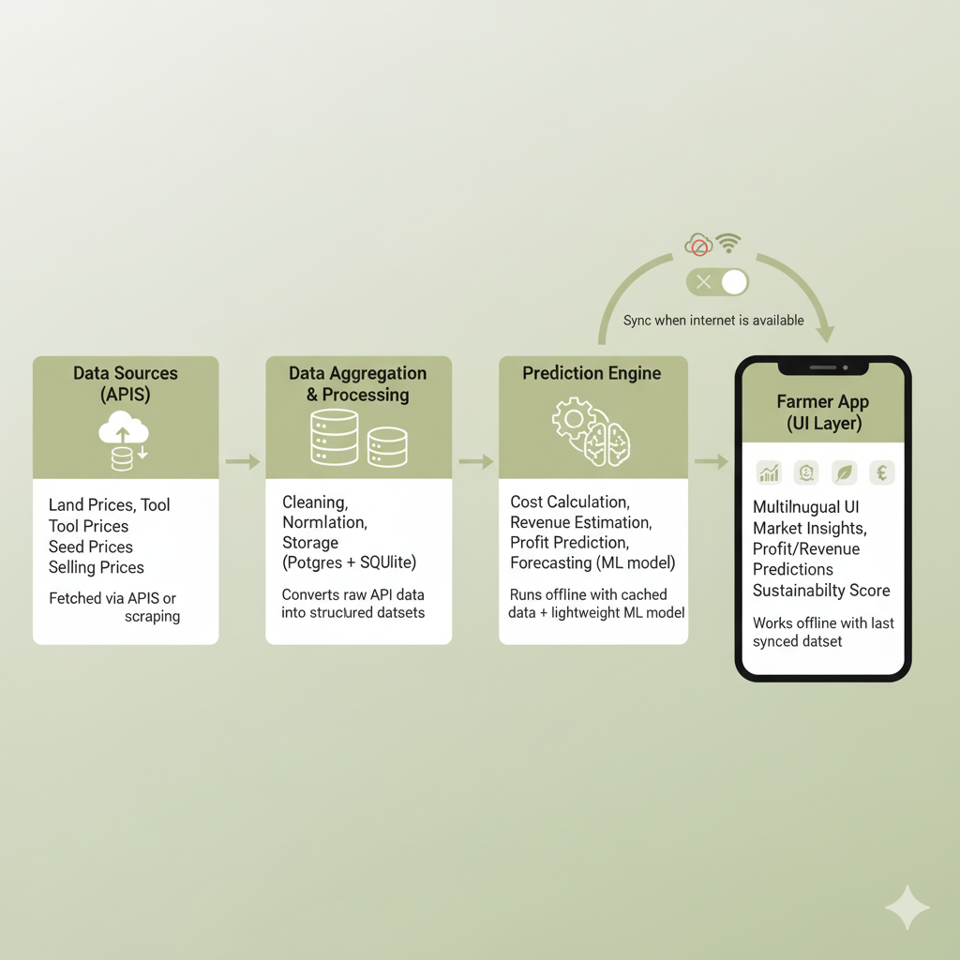
TECHNICAL APPROACH
Cipher
Squad
Process Flow
Farmer inputs location, land area, optional soil, seeds, water, crop image
System integrates inputs with weather, soil, and market data
AI predicts crops, yield, profit; analyzes disease and suggests treatment
Recommendations delivered in local language; alerts sent when relevant
Technologies Used
Mobile App: React Native (cross-platform, offline-capable)
AI/ML: Hugging Face (disease), Gemini (crop prediction)
Data Sources: IMD API for weather, Bhuvan, Soil Health Cards, AgriStack for market data
Backend & Security: Cloud hosting, PostgreSQL/Firebase, encrypted land-linked data
Notes:
->Figma flow diagram
1.Data Sources (APIs)-[Label: “Land Prices, Tool Prices, Seed Prices, Selling Prices”.
Note: “Fetched via APIs or scraping”.
implementation: Set up API connectors (REST calls), Scheduler (e.g., CRON jobs) to pull daily/hourly data, Cache recent responses for offline sync.]
2. Data Aggregation & Processing- [Label: “Cleaning, Normalization, Storage (Postgres + SQLite)”.
Note: “Converts raw API data into structured datasets”.
implementation: ETL pipeline (Python scripts / Node.js backend), Local DB sync module in the app to download latest snapshot.]
3. Prediction Engine-[Label: “Cost Calculation, Revenue Estimation, Profit Prediction, Forecasting (ML model)”.
Note: “Runs offline with cached data + lightweight ML model”.
implementation: Train model centrally, deploy ONNX/TFLite lightweight model inside the app, Runs offline using last cached data]
4. Farmer App (UI Layer)-[Label: “Multilingual UI, Market Insights, Profit/Revenue Predictions, Sustainability Score”.
Note: “Works offline with last synced dataset”.
implementation: Flutter/React Native,Local storage (SQLite/Realm DB),Background sync when online.]
Data downloaded when internet available & automatic download if given consent
Gemini and whisper models to implement chat

Slide 4
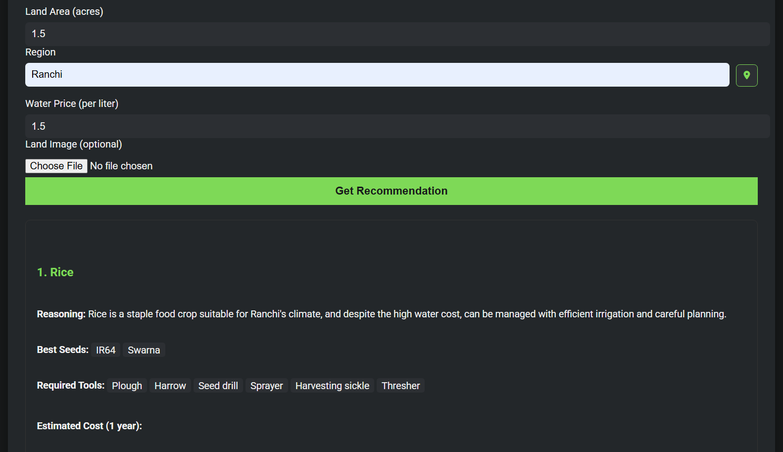
FEASIBILITY AND VIABILITY
Cipher
Squad
Feasibility
Uses public datasets: Soil Health Cards, Bhuvan, AgriStack, IMD
AI models detect disease and predict crops accurately
Offline support and low-end phone compatibility
Encrypted land-linked data with consent-based handling
To prove feasibility of our idea, we already, built a small working prototype
Viability
Low-cost by leveraging existing APIs and datasets
Scalable across regions and multiple crops
Intuitive multilingual interface with voice/text support
Boosts yield, reduces waste, and encourages sustainability
Notes:
Prototype demonstration

Slide 5
IMPACT AND BENEFITS
Cipher
Squad
Feature | Impact | Benefit
Offline Functionality | Works in low/no connectivity areas | Farmers in remote regions can access advice anytime
AI-Driven Crop & Disease Predictions | Provides yield, profit, crop choice, and disease forecasts | Enables smarter decisions, reduces crop loss, improves profitability
Multilingual Voice & Chat | Supports local languages and natural interactions | Inclusive access for low-literacy farmers
Market & Sustainability Insights | Suggests crop choices considering supply, prices, and soil health | Preserves soil, prevents oversupply, maximizes long-term income

Slide 6
RESEARCH AND REFERENCES
Cipher
Squad
Resource | Detail | Link
Soil Health Cards | Farm soil nutrient data | https://soilhealth.dac.gov.in
Bhuvan | Satellite soil and land mapping | https://bhuvan.nrsc.gov.in
NASA POWER | Weather, solar, climate data | https://power.larc.nasa.gov
IndianAPI | Aggregated government agri & weather APIs | https://www.indianapi.in
SAMETI | Agricultural guidelines and advisory frameworks | https://www.sameti.org
Note: Text formatted like this is a hyperlink

